Slide 1
HOOGHLY WOMEN’S COLLEGE
SUBJECT : HISTORY
SEMESTER VI
HONOURS CORE COURSE
PAPER XIV
TOPIC: POST WAR DEVELOPMENT
BARNALI CHATTOPADHYAY
DEPARTMENT OF HISTORY

Slide 2
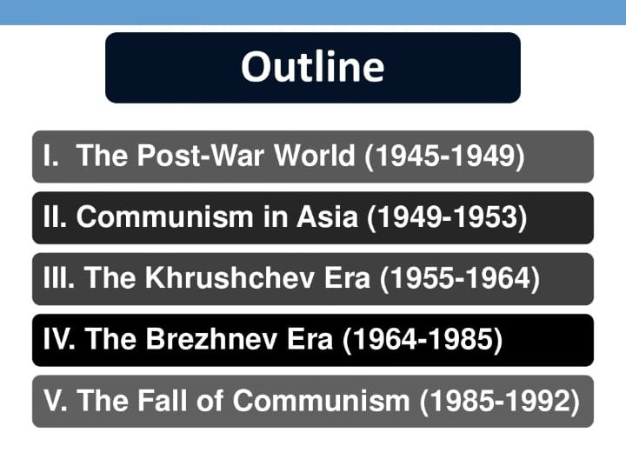
TOPIC: POST WAR DEVELOPMENT

Slide 3
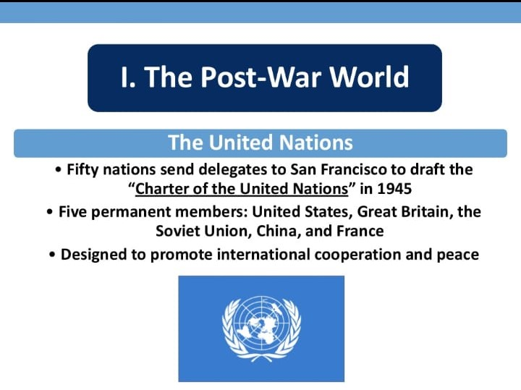
TOPIC: POST WAR DEVELOPMENT

Slide 4
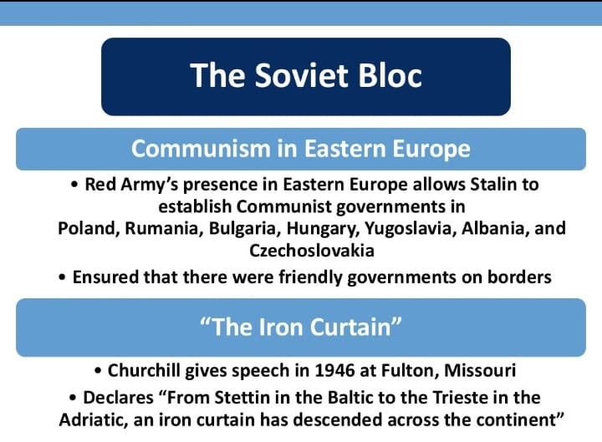
TOPIC: POST WAR DEVELOPMENT

Slide 5
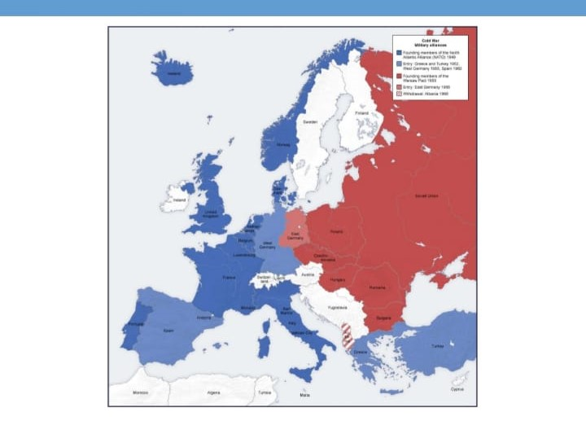
TOPIC: POST WAR DEVELOPMENT

Slide 6
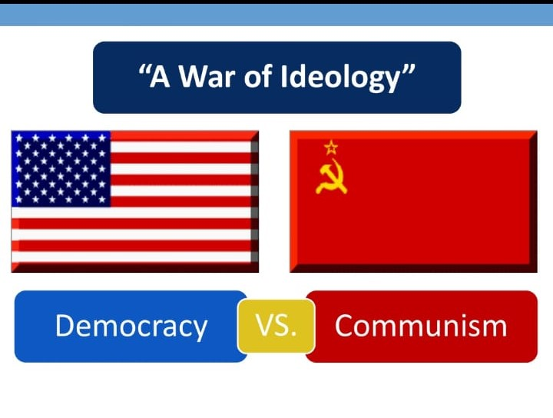
TOPIC: POST WAR DEVELOPMENT

Slide 7
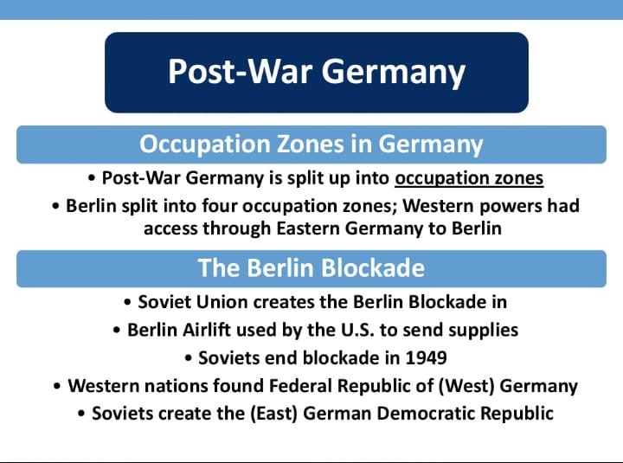
TOPIC: POST WAR DEVELOPMENT

Slide 8
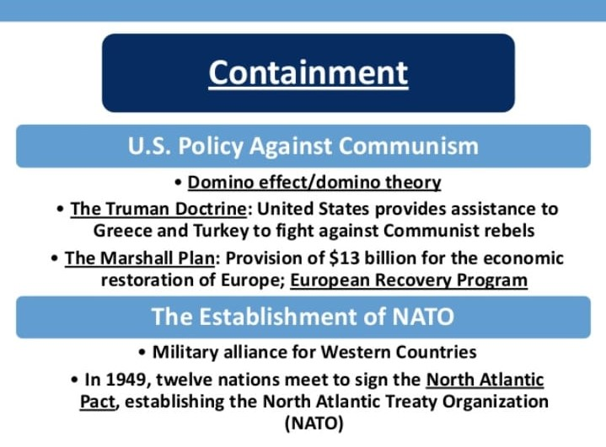
TOPIC: POST WAR DEVELOPMENT

Slide 9
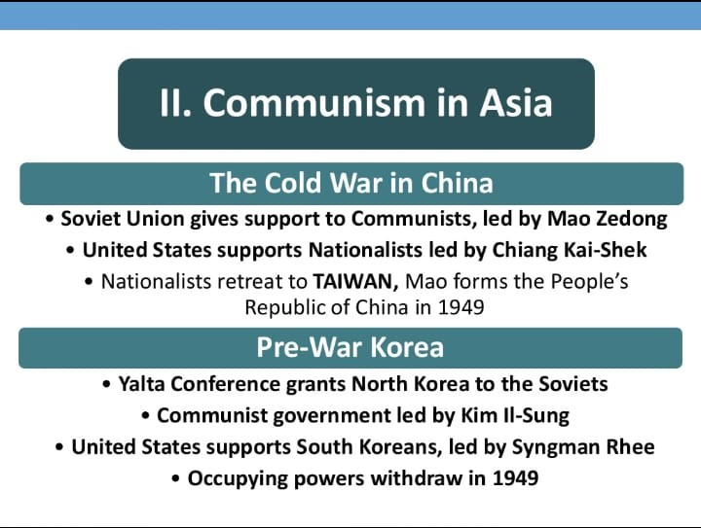
TOPIC: POST WAR DEVELOPMENT

Slide 10
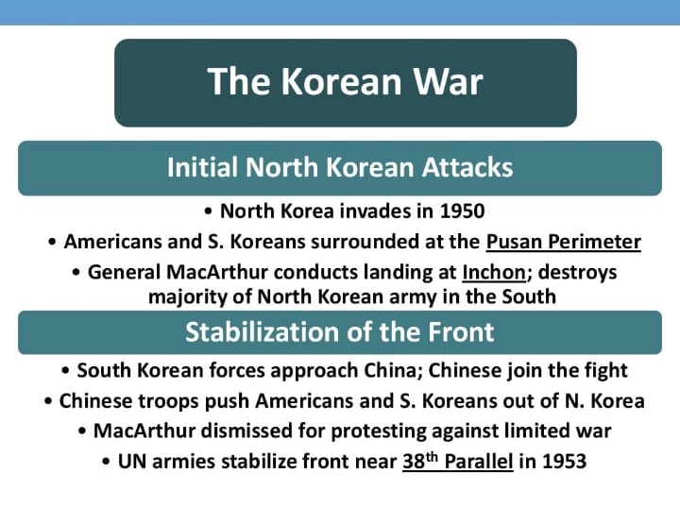
TOPIC: POST WAR DEVELOPMENT

Slide 11
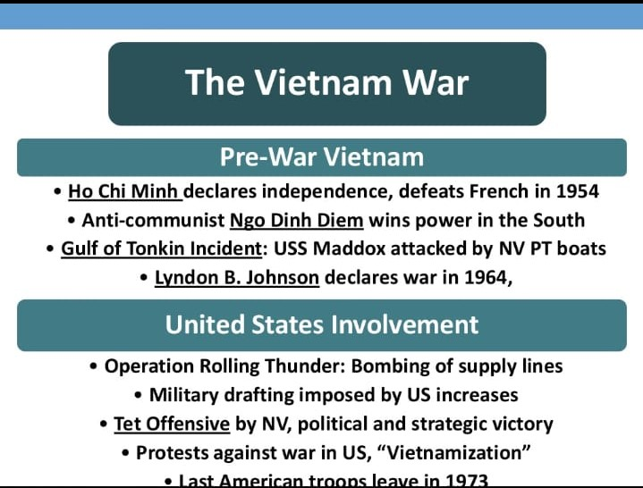
TOPIC: POST WAR DEVELOPMENT

Slide 12
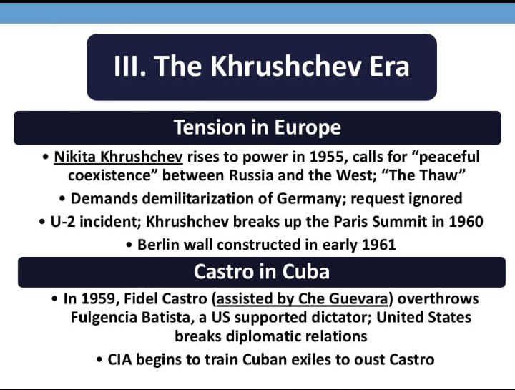
TOPIC: POST WAR DEVELOPMENT

Slide 13
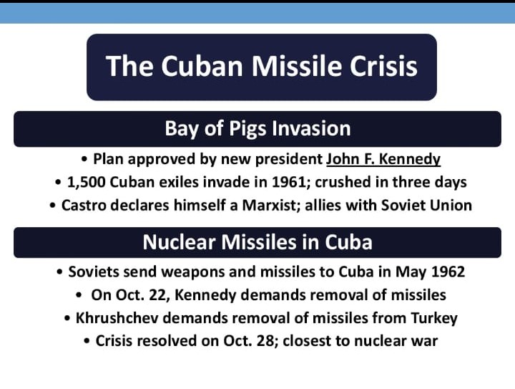
TOPIC: POST WAR DEVELOPMENT

Slide 14
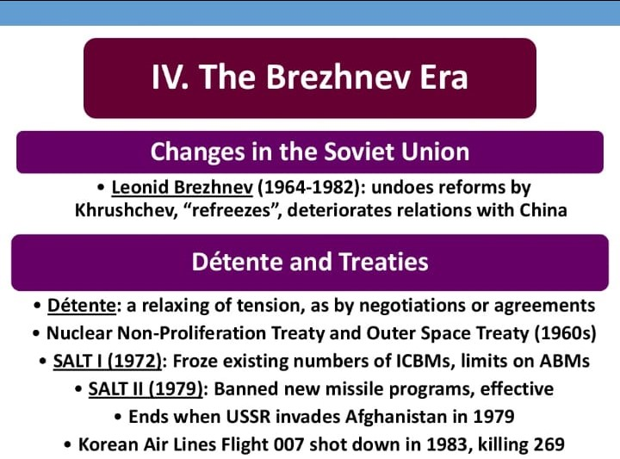
TOPIC: POST WAR DEVELOPMENT

Slide 15
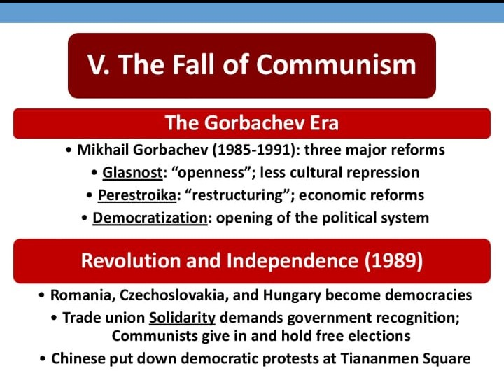
TOPIC: POST WAR DEVELOPMENT

Slide 16
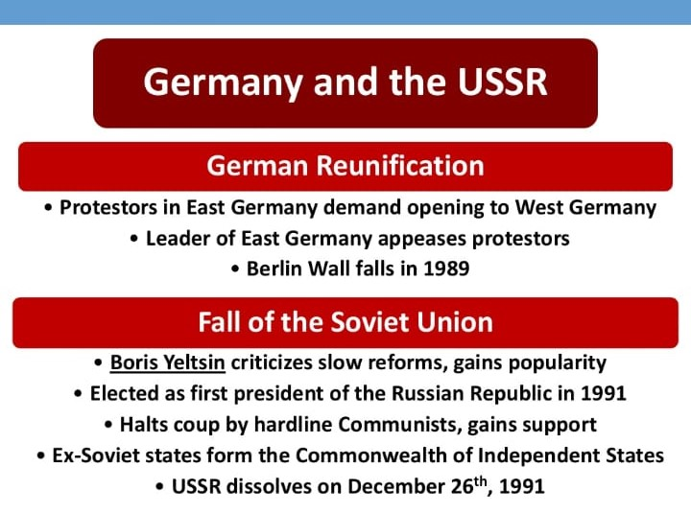
TOPIC: POST WAR DEVELOPMENT

